Slide 1

J. Dearmon & R. Grier

Slide 2
Introduction
How does trust play a role in increasing income?
This paper tests the effects of trust on human capital and physical capital. They assume two capital forms are jointly determined
Previous studies investigated into only the relationship between trust and human capital or between trust and physical capital

Slide 3
Literature on the endogeneity of human and physical capital
Education fosters the innovation and new technology (Nelson & Phelps, 1966)
New technology increases the demand for skilled labor (Upadhyay, 1994)
Increase in physical capital raises the return to education (Caballe & Santos 1993; Sanqin & Philippopoulous 1995)
A lack of physical capital and a lack of human capital are related to one another (Romer, 1993)
However, many studies do not show the empirical linkage between human and physical capital

Slide 4
Effects of trust on human capital
Trust increases the demand and supply for human capital (Bjornskov, 2006)
  Firms hire more skilled labor in higher level of trust because trust decreases the monitoring cost
  Individuals can obtain credible information about human capital skills they require
  Positive relationship between secondary school and trust (Knack& Keefer, 1997; Bjornskov, 2008)

Slide 5
Effects of trust on physical capital
Higher trust reduces imperfect information. That increases investment opportunities
Higher trust reduces the time and cost of extensive contracts
Positive relationship between trust and physical capital was found in a cross section of 41 countries (Zak & Knack, 2001)

Slide 6
Framework
Sample 50 countries from 1976 to 2004
Trust
Data Source: Question A165 from the World Values Survey
Q. Generally speaking, would you say that most people can be trusted or that you can’t be too careful in dealing with people
A. 1. Most people can be trusted
2.Can’t be too careful in dealing with people
Answer 2 Trust value zero
Wave 1: 1981-1984 ,Wave 2: 1989-1993, Wave 3: 1994-1998, Wave 4: 1999-2004
Average all the individual responses for each country and wave

Slide 7
Framework
Human capital
Data Source: Barro and Lee dataset (2001)
Five years interval
The percentage of population over age 15 who have reached or attained the secondary education level
Select data that is the closest to the first year of the WVS wave
Physical capital
Data Source: Penn World Tables
The investment share of real GDP
Average annual data to correspond to time period of WVS wave

Slide 8
Framework
Instrumental Variables
Physical capital investment
One period lagged : Initial observation from 1976-1980 to correspond to wave 1
1. Macro economic variables
a. Inflation
Data Source: International Financial Statistics CPI data from the IMF
Relationship between inflation and investment
  Phillips curve &Tobin effect: Inflation has positive effects on physical investment
  High inflation rate decreases investment due to the increase in uncertainty of the return to physical investment

Slide 9
Framework
b. Real GDP growth rate
Data Source: Penn World Table
Higher growth rate works positively for physical capital
c. Government spending
Data source: Penn World Table
Existing literature shows that the growth of government’s share of real GDP is negative for physical capital

Slide 10
Framework
2. Political instability
Measured by Regime Change in the test
Data source: Polity IV database
Dummy variable
  1-Regime change occurred during the wave
Political instability has negative effects on physical capital investment
i.e.) Weak property rights enforcement

Slide 11
Framework
Instrumental Variables
Human capital investment
1. Cultural variables
a) Religion dummy
Data source: Shared Global Indicators
Two dummy variables: Catholic and Protestant
1- Majority of the country is Protestant or Catholic
b) Ethno-linguistic diversity
Data source: Shared Global Indicators
The probability that any two people from a country will not have the same ethno-linguistic background

Slide 12
Model
Model 1- Trust is linear regressor in both education and investment equation
Model 2- Include trust squared into an investment equation to capture the diminishing returns to trust
Three stage least squares (3SLS)
Assumption: Political and macro economic variables directly affect only investment and cultural variables directly affect only secondary education

Slide 13
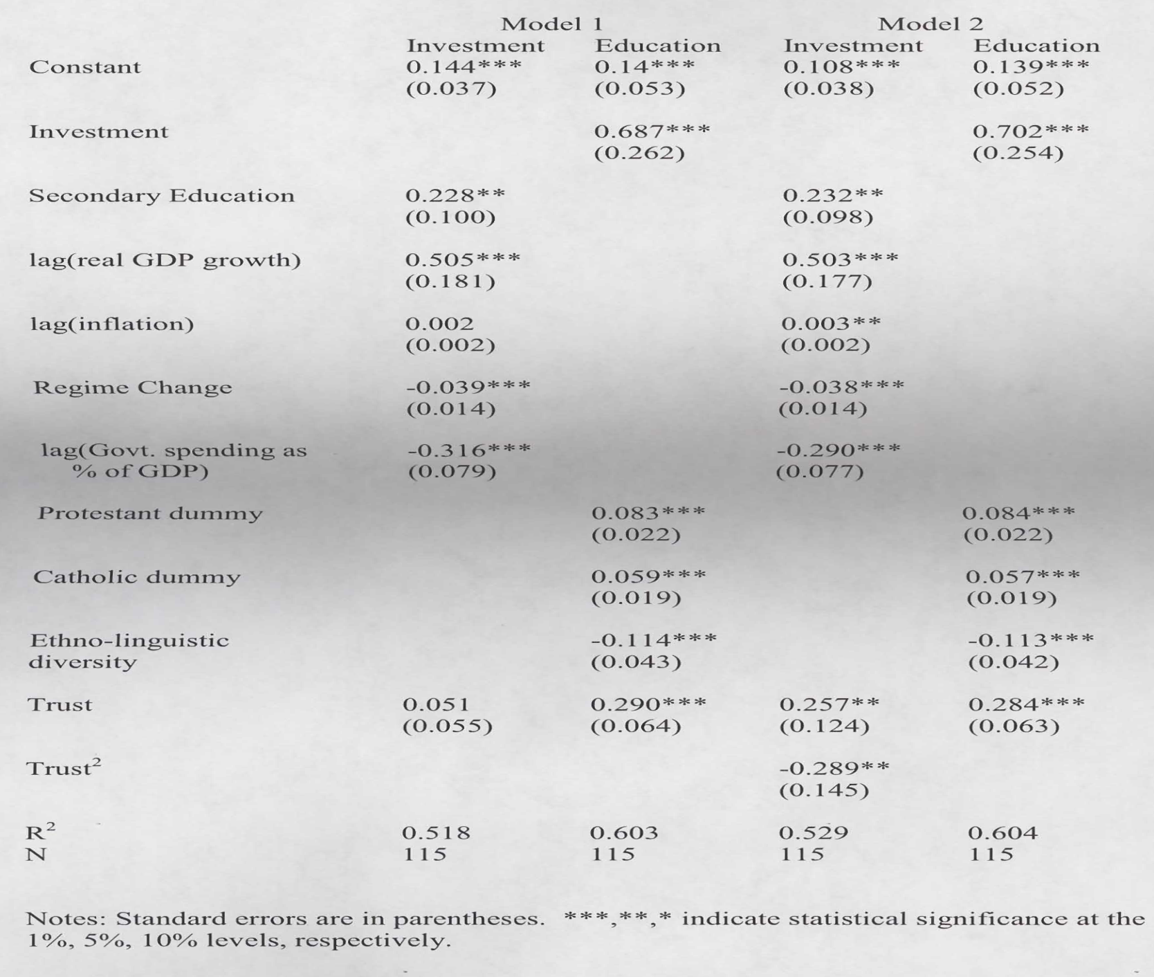
Test Result

Slide 14
Test result
Model 1
  The coefficient of Education in an investment equation is positive and significant . Similarly, the coefficient of Investment in an education equation is also positive and significant
  The increase in each of capital brings positive spillovers to the other
  Except for coefficients of Inflation and Trust in an investment equation, all coefficients have expected signs and statistically significant
Model 2
  After adding trust squared into an investment function, the coefficient of Trust becomes significant at 5 % level
  Diminishing returns to trust

Slide 15
Quantitative effects of trust on capital
Consider indirect effects of explanatory variables in a physical (human) capital equation to a human (physical) capital equation. Which independent variable has bigger effects on capital in long run?
Estimation
Find the reduced form coefficient in model 2
Measure the effects of trust on investment and secondary education when all other variables are set at their mean value
Result: Effects of trust are positive but diminishing

Slide 16
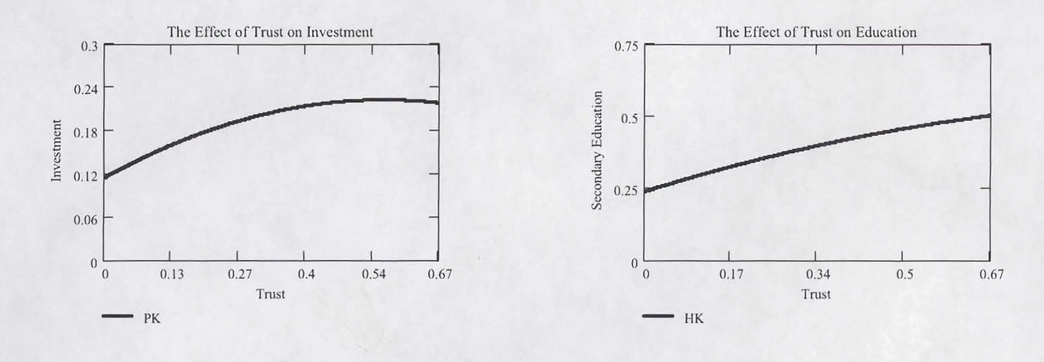
Quantitative effects of trust on capital

Slide 17
Quantitative effects of trust on capital
Increase in trust has larger effects in low-trust country than high-trust countries
1. low-trust country
Change in trust level 5% (Peru) to 21% (France) increases investment by 70% of a standard deviation and education by 61% of a standard deviation
2. high-trust country
Change in trust level 34% (Australia) to 48% (new Zealand) increases investment by only 25% and education by 44% of a standard deviation

Slide 18
Quantitative effects of other explanatory variables on capital
Religion dummies
The change in religion dummies brings the biggest quantitative effect on secondary education
Change in Protestant (Catholic) dummy from o to 1 increases secondary education by 76% (51.8%) of a standard deviation and investment by 34% (23.2 %)of a standard deviation
Political instability
The occurrence of political change decreases secondary education by 24.2% and investment by 66.4%

Slide 19
Robustness check
Jackknife method
  Run fifty 3SLS regressions by removing a different country each time
  All of the coefficient estimates in both equations are positive and concentrated around their mean value
  The coefficient of trust is robust. The standard deviation of trust’s coefficient is less than 9% of the mean in an investment equation and 3.5 % in an education equation. Coefficient of trust squared is also around 9% of the mean

Slide 20
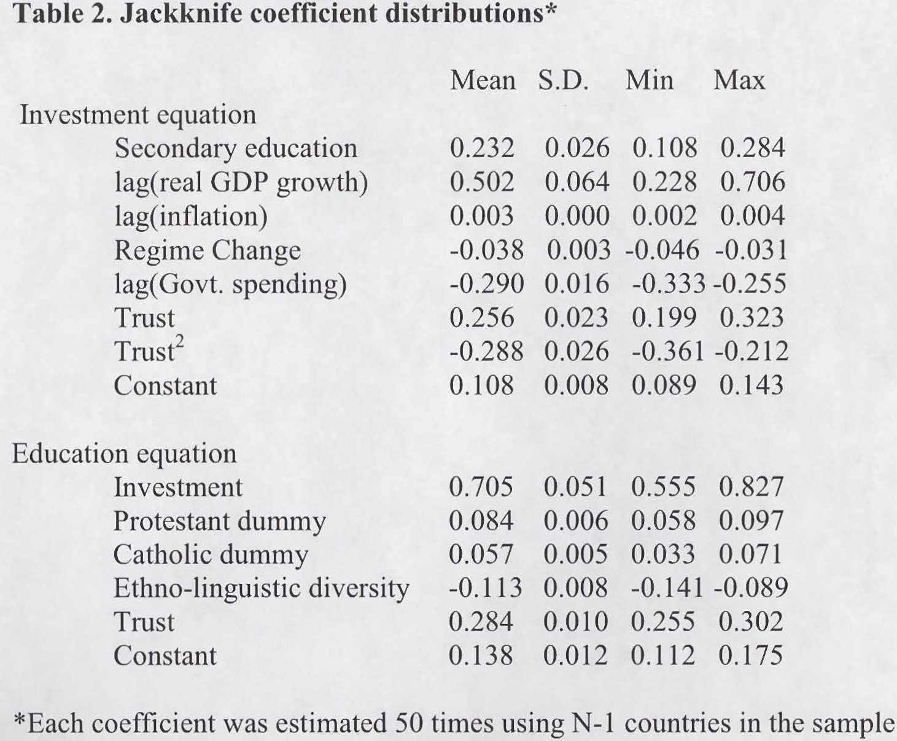

Slide 21
Conclusion
Human and physical capital are simultaneously determined
Trust affects both human capital and physical capital positively and significantly but its marginal effect diminishes
Increase in trust helps more in low trust countries
Further research: How can policies be constructed to increase the trust?

